Slide 1
Introduction To Elasticsearch
Rod Paddock, Cedar Park TX

Slide 2

Our Sponsors

Slide 3
About…
Hello My Name Is Rod Paddock
I solve problems!
I’m @rodpaddock on Twitter
My company site is www.dashpoint.com
I’m Editor in Chief of Code Magazine (www.codemag.com)

Slide 4
What is Elasticsearch
What if you wanted to add the capabilities of Google/Bing to your applications?
There’s an application for that. It’s called Elasticsearch
Open Source
Written in Java
Wrapper over Lucene (Think Google light)
Highly scalable(clustered by design)
Data stored in JSON
Queries built in JSON
Capable of HUGE scale.

Slide 5
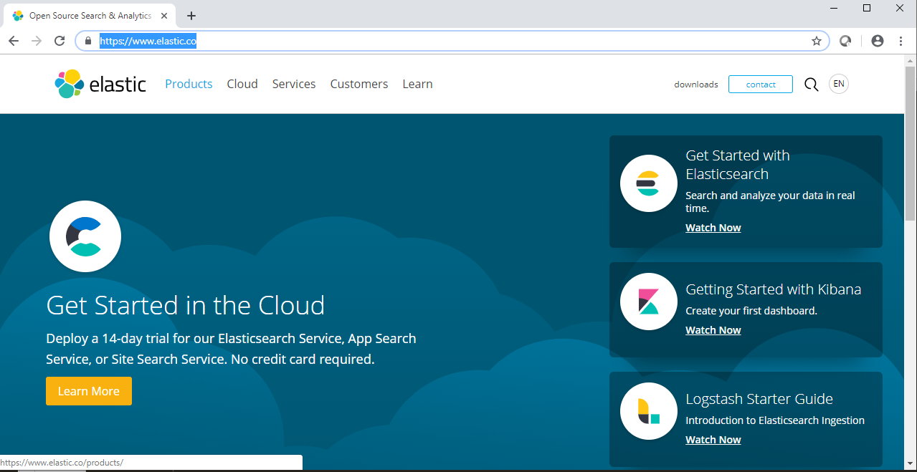
Installing Elasticsearch
www.elastic.co
Installers for Mac, Windows, Linux

Slide 6
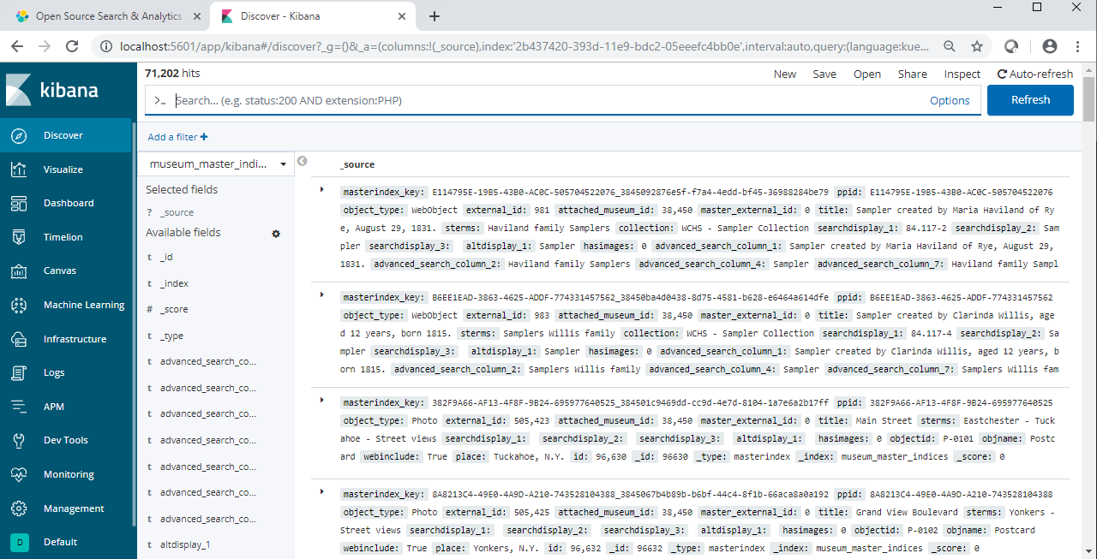
You’re Gonna Need a Better Tool: Kibana
Graphical Front End For Managing Elasticsearch

Slide 7
A Tool for C# Developers: NEST
Nest is an open source library that can be used to:
Connect to Elasticsearch
Load data into Elasticsearch
Query data from Elasticsearch
Install-Package NEST
https://www.github.com/elasticsearch-net

Slide 8
Demo Time:
1. Connecting to Elasticsearch
2. Loading data into Elasticsearch
3. Querying data from Elasticsearch

Slide 9
1. Connecting to Elastic Search
public static ElasticClient GetElasticClient(string indexName)
{
var url ="http://localhost:9200";
var node = new Uri(url);
var settings = new ConnectionSettings(node);
settings.DefaultIndex(indexName);
var client = new ElasticClient(settings);
return client;
}

Slide 10
2. Loading data into Elasticsearch
By default Elasticsearch uses a property called Id for it’s “key”
You can override the Id property name to use another
Can be Int32, Int64, String or Guid
The NEST Library will turn CLR objects into JSON format used by Elasticsearch
Objects (Documents) are stored in a construct known as an Index
ONE type(class) per index
CLR objects sent to Elasticsearch can be Compound

Slide 11
2. Loading data into Elasticsearch Cont…
var waitHandle = new CountdownEvent(1);
var bulkAll = client.BulkAll(dataToProcess, b => b
.Index(indexName)
.BackOffRetries(2)
.BackOffTime("30s")
.RefreshOnCompleted(true)
.MaxDegreeOfParallelism(4)
.Size(10000));
bulkAll.Subscribe(new BulkAllObserver(
onNext: (b) => { Console.Write("."); },
onError: (err) =>
{
var x = err;
throw err;
},
onCompleted: () => waitHandle.Signal()
));
waitHandle.Wait();

Slide 12
2. Loading data into Elasticsearch
Load One Record At a Time
foreach (var doc in clients)
{
var resp = client.Index(doc,
idx => idx.Index("prarie_devcon_2019_directors"));
}

Slide 13
3. Querying data from Elasticsearch
1. Build a new List<QueryContainer>
Used to stack queries
2. Add Google Style Query
Create instance of QueryStringFilter
Make sure to upper case your ANDs and ORs
Filter Data
Create instances of MatchQuery
Limit search fields
Return JSON from Query Def
Working with Results
Documents Returned
Other Metadata

Slide 14
Q&A
https://github.com/rjpaddock/IntroductionToElasticSearch
Sample Data: https://www.imdb.com/interfaces/

